Slide 1

Wiener path integral based stochastic response determination of nonlinear systems with singular diffusion matrices
8th Computational Stochastic Mechanics Conference (CMS8)
Paros, Greece
June 9-13, 2018
Ioannis Petromichelakis, Apostolos F. Psaros and Ioannis A. Kougioumtzoglou
Dept. of Civil Engineering & Engineering Mechanics
Columbia University, USA

Slide 2
Outline
Introduction
Wiener path integral (WPI) technique
Standard formulation
Modification
E-L equations and Lagrange Multipliers
Rayleigh-Ritz and Constrained Optimization
Linear constraints
Nonlinear constraints
Conclusions

Slide 3
Outline
Introduction
Wiener path integral (WPI) technique
Standard formulation
Modification
E-L equations and Lagrange Multipliers
Rayleigh-Ritz and Constrained Optimization
Linear constraints
Nonlinear constraints
Conclusions

Slide 4


Introduction
Engineering Stochastic Dynamics
Wiener Path Integral (WPI) techniques transition PDF
Theory of Stochastic Differential Equations (SDEs)
Mechanical oscillators under white noise excitation: 2nd order SDEs
Chaichian and Demichev (2001) Path integrals in physics. Vol. 1. CRC Press
Singular diffusion matrix
Mechanical oscillators under non-white excitation: higher order SDEs
Psaros, Brudastova, Malara & Kougioumtzoglou, J Sound & Vibration (Under Review)

Slide 5
Introduction
A wide class of stochastic dynamics problems can be modeled as:
: White noise vector process
Cases:
Filtered white noise excitation processes
Nonlinear vibratory energy harvesters
Partially (stochastically) forced structures
Hysteretic systems, e.g. Bouc-Wen oscillator
Lead to singular diffusion matrices

Slide 6
Outline
Introduction
Wiener path integral (WPI) technique
Standard formulation
Modification
E-L equations and Lagrange Multipliers
Rayleigh-Ritz and Constrained Optimization
Linear constraints
Nonlinear constraints
Conclusions

Slide 7
WPI technique - Standard formulation
Wiener path integral (WPI) Wiener (1921), Feynman (1948)
Transition probability density
State Space
.
.
.
Lagrangian functional
Determine by solving:
Variational problem
Euler-Lagrange equations
minimize
Rayleigh-Ritz direct method

Slide 8
WPI technique - Standard formulation
1. From Calculus of Variations
Euler-Lagrange equations
extremality
condition:
2. The Rayleigh-Ritz direct method
polynomial basis expansion of the response
coefficient matrix
Then the functional becomes a function of
Enables the utilization of optimization theory and algorithms
If the diffusion matrix is singular is singular

Slide 9
Treatment of diffusion matrix singularity
Separation of the governing equations into two underdetermined systems
SDEs
system equations
Homogeneous ODEs
constraints
The Lagrangian of the system equations is written as:
: non-singular square submatrix of
Constrained variational problem
Two solution approaches
minimize
Euler-Lagrange equations
Rayleigh-Ritz direct method
subject to

Slide 10
Outline
Introduction
Wiener path integral (WPI) technique
Standard formulation
Modification
E-L equations and Lagrange Multipliers
Rayleigh-Ritz and Constrained Optimization
Linear constraints
Nonlinear constraints
Conclusions

Slide 11
EL equations and Lagrange multipliers
From Calculus of Variations
Lagrange multiplier
vector function
Unconstrained variational problem
minimize
where
The most probable path is the solution of the system:
n E-L equations + m constraints
Reduction of these high order ODEs to first order
Numerical methods
requires multiple differentiations of the constraints
Computational complications
Gear, Leimkuhler, and Gupta (1985) J Comp. & Applied Math.

Slide 12
Outline
Introduction
Wiener path integral (WPI) technique
Standard formulation
Modification
E-L equations and Lagrange Multipliers
Rayleigh-Ritz and Constrained Optimization
Linear constraints
Nonlinear constraints
Conclusions

Slide 13
Rayleigh-Ritz method and Constrained Optimization
Polynomial basis expansion
functional
nonlinear function
Linear constraints
functions are polynomials in with coefficients linear in
equate all polynomial coefficients to zero
minimize subject to
Nonlinear optimization problem with linear equality constraints
Efficient solution using nullspace of
restrict to the subspace of where is always satified

Slide 14
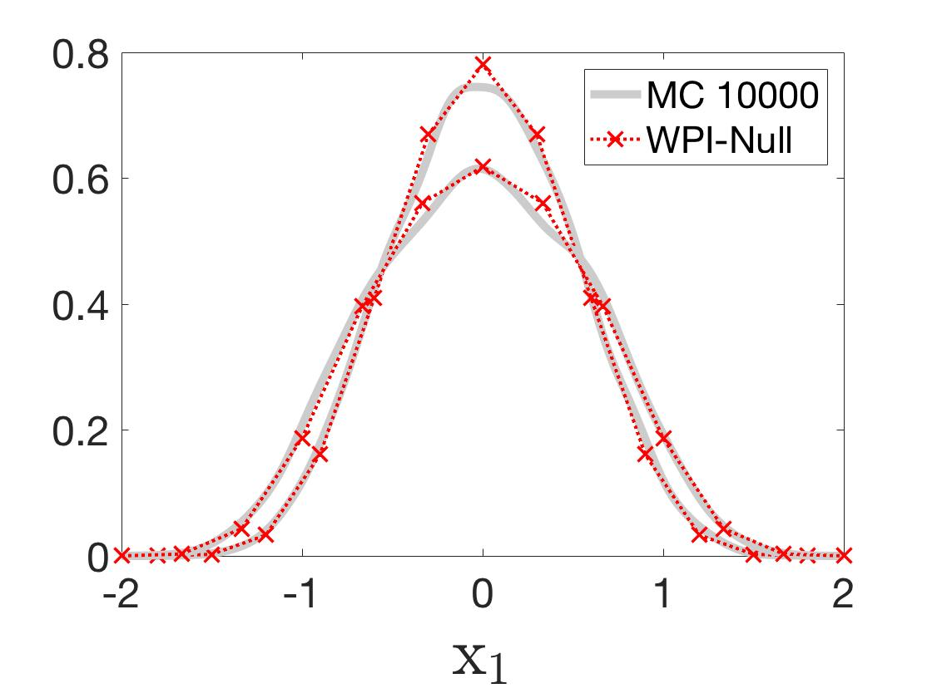
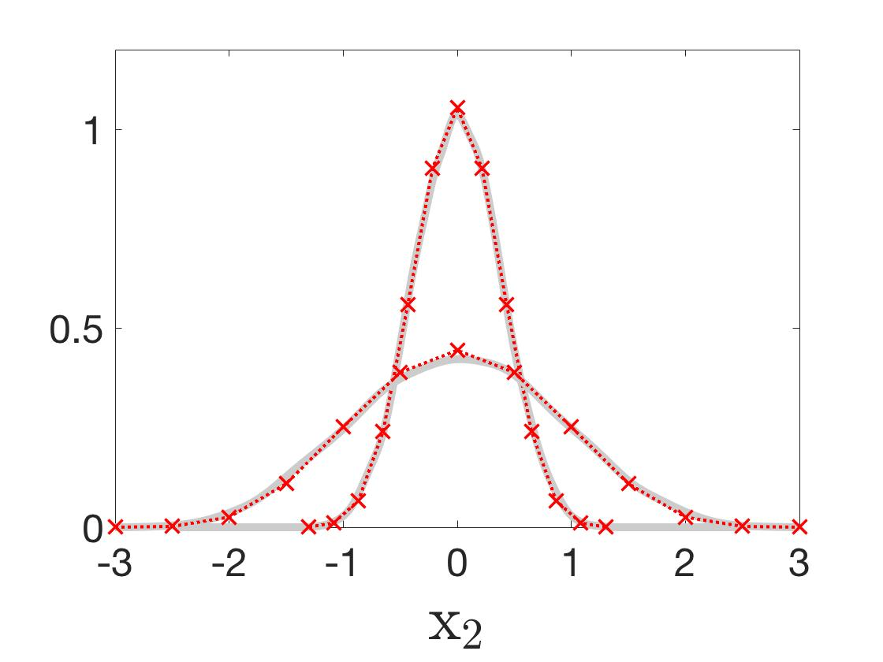
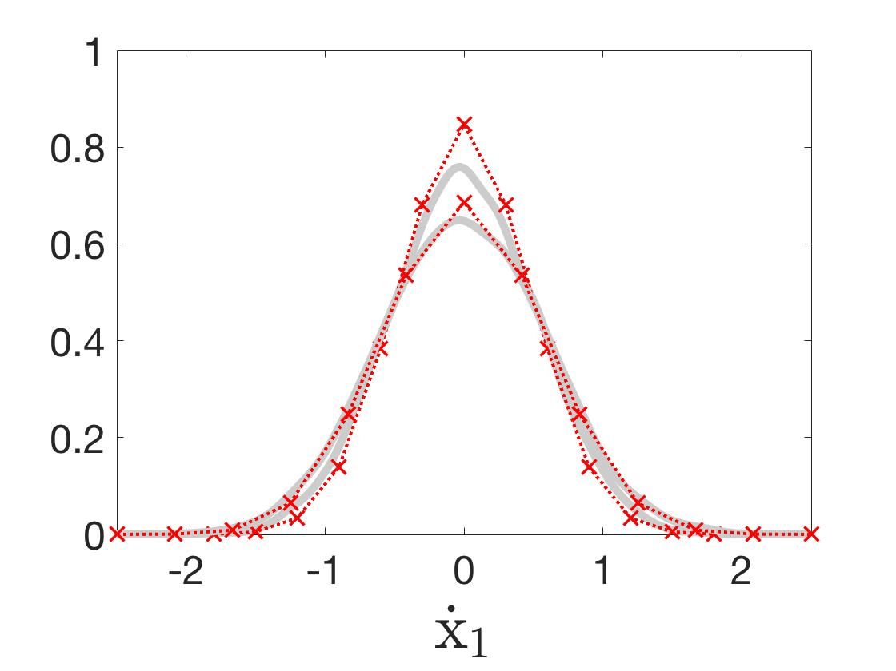
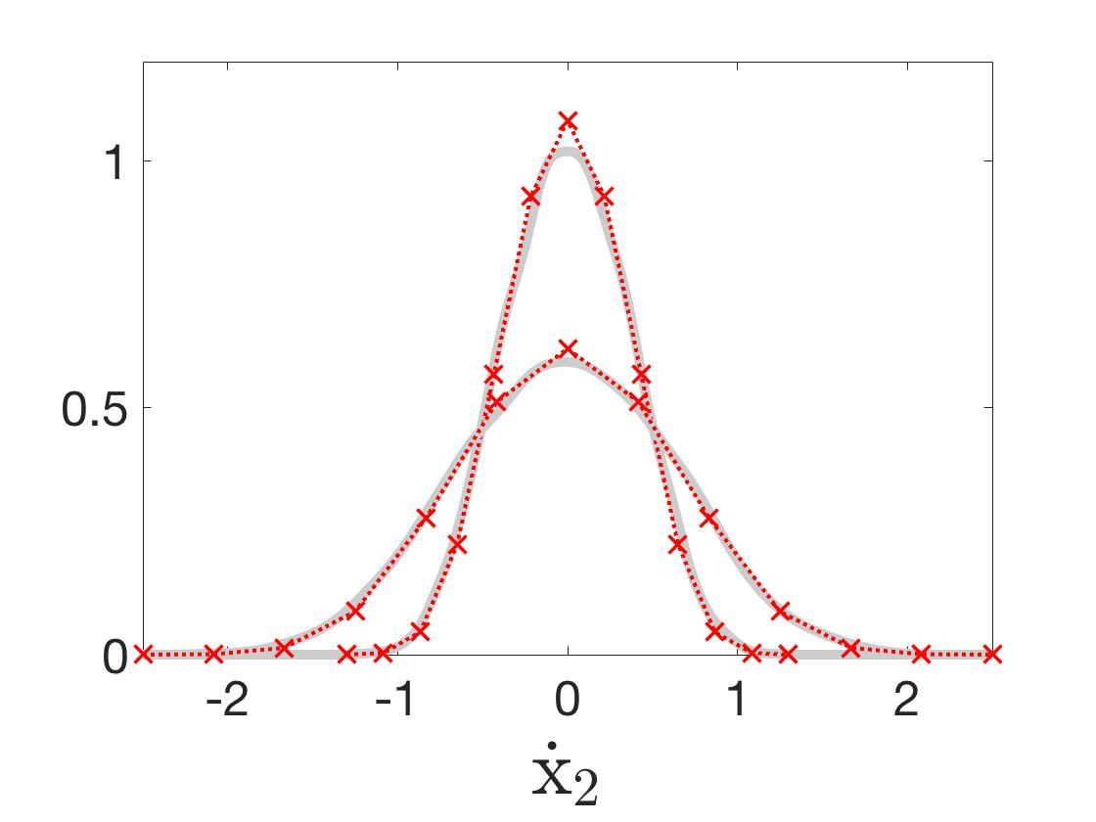
1st Example: Partially forced 2 DOF oscillator
t=2 sec
t=12 sec
nonlinear eq. of motion
linear constraint

Slide 15
Rayleigh-Ritz method and Constrained Optimization
Polynomial basis expansion
functional
nonlinear function
Nonlinear constraints
minimize subject to
Nonlinear optimization problem with nonlinear equality constraints
Augmented Lagrangian method
Dual of the Quadradic Penalty Method (QPM)
Bertsekas (1985) Constrained Opt. and Lagrange Multiplier Methods
for and increasing
Computational improvement over the QPM
Nocedal, Wright (2006) Numerical Optimization

Slide 16
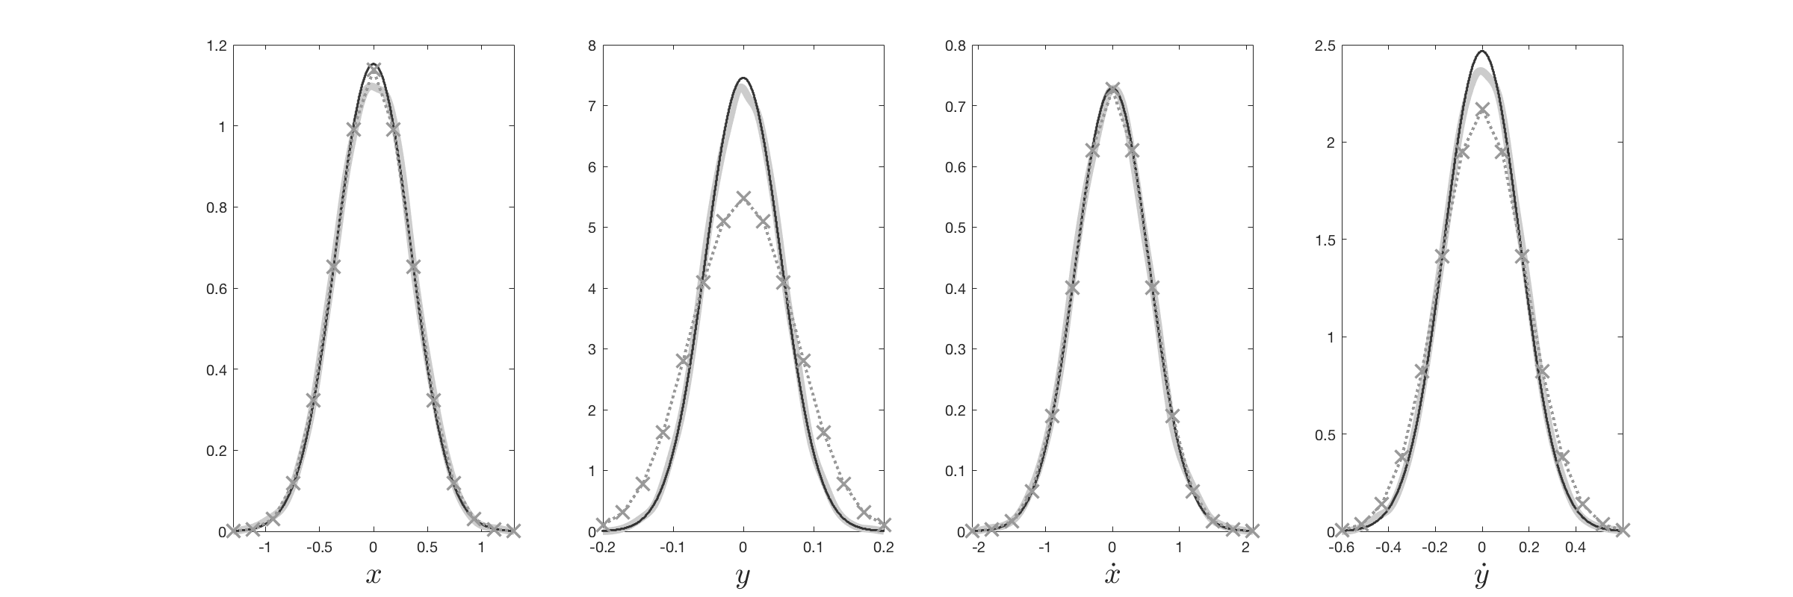
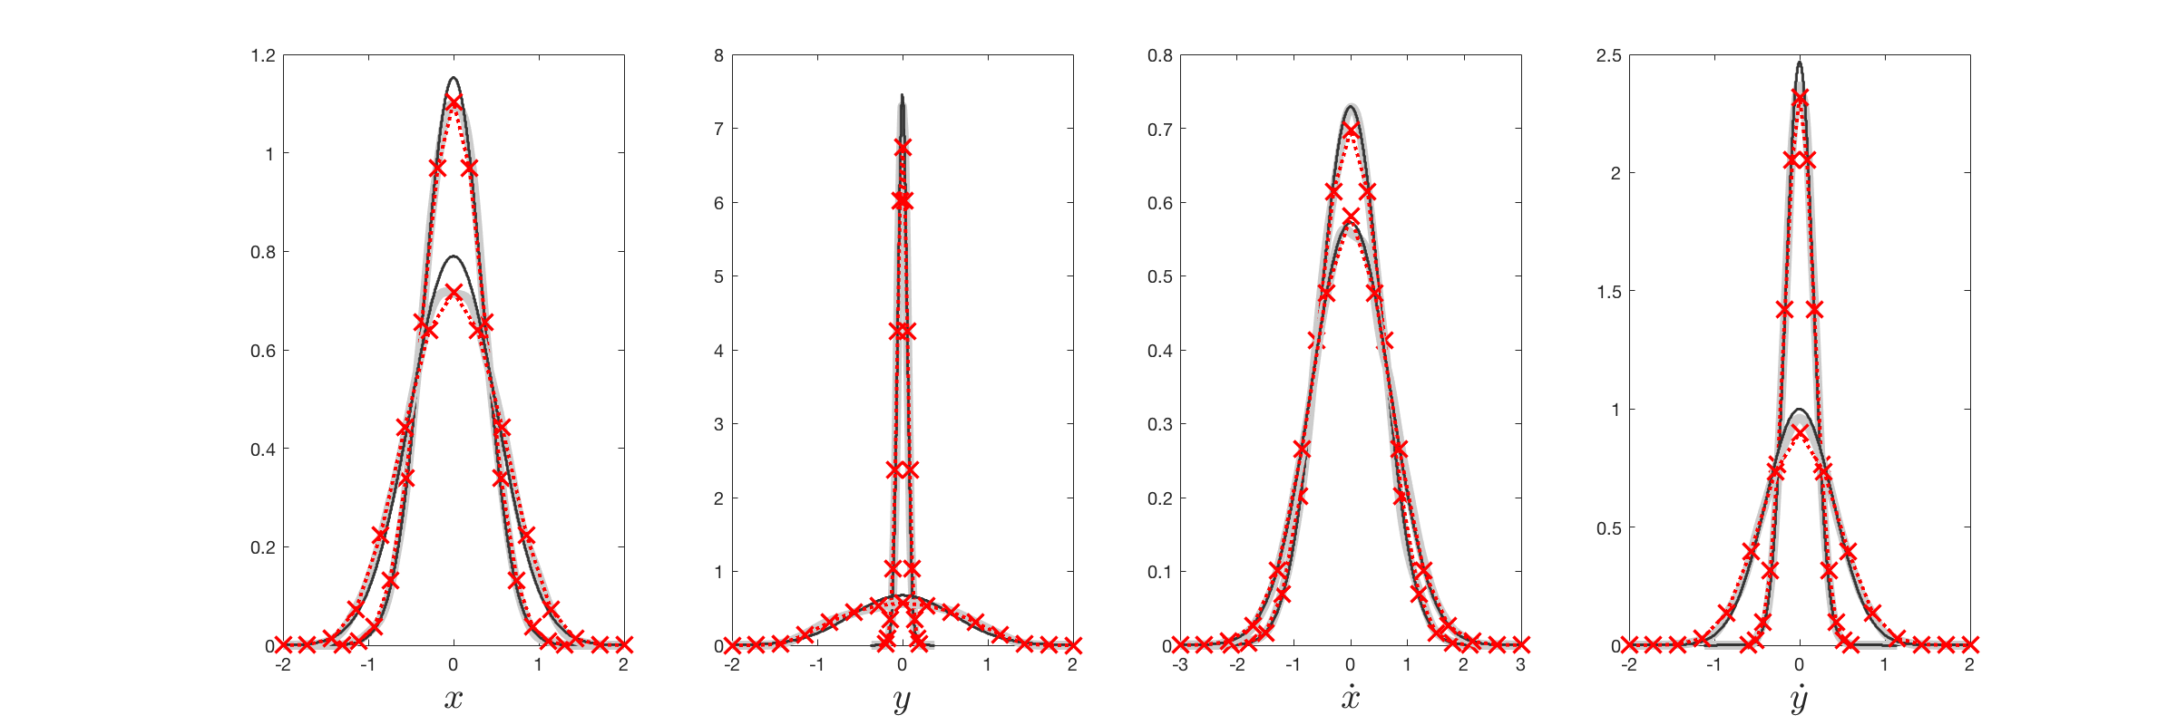
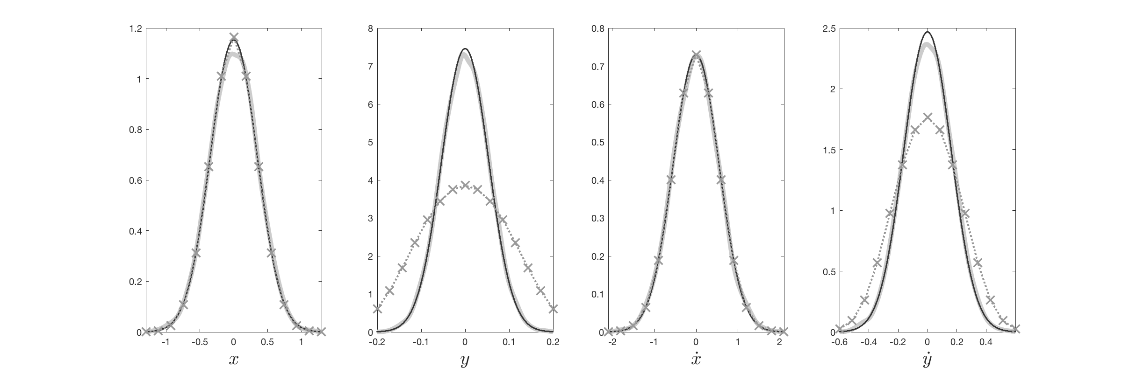
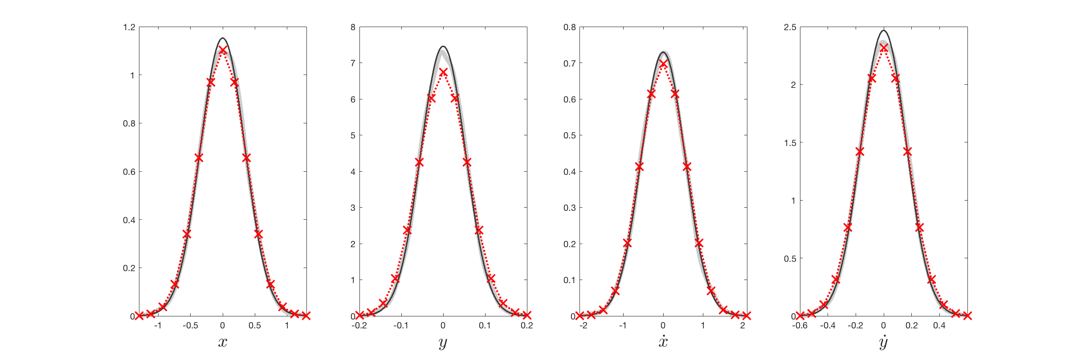
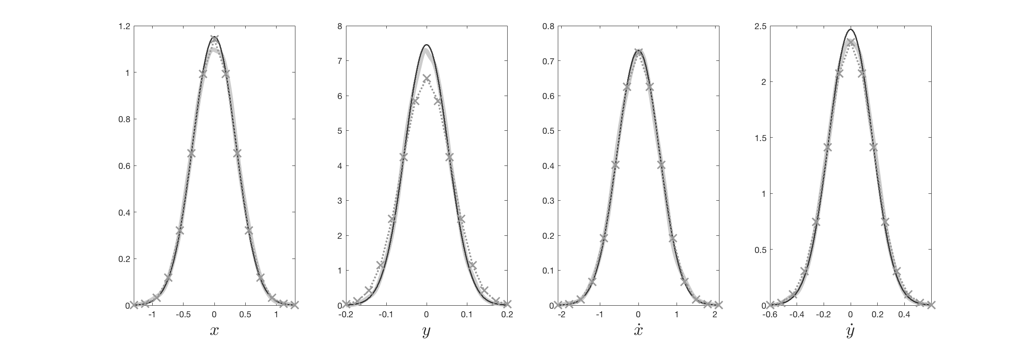
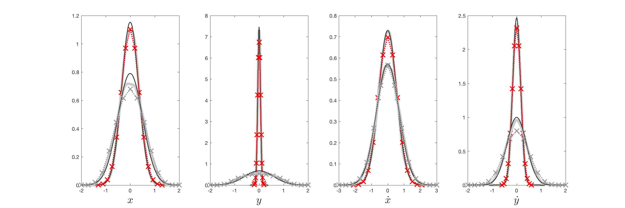
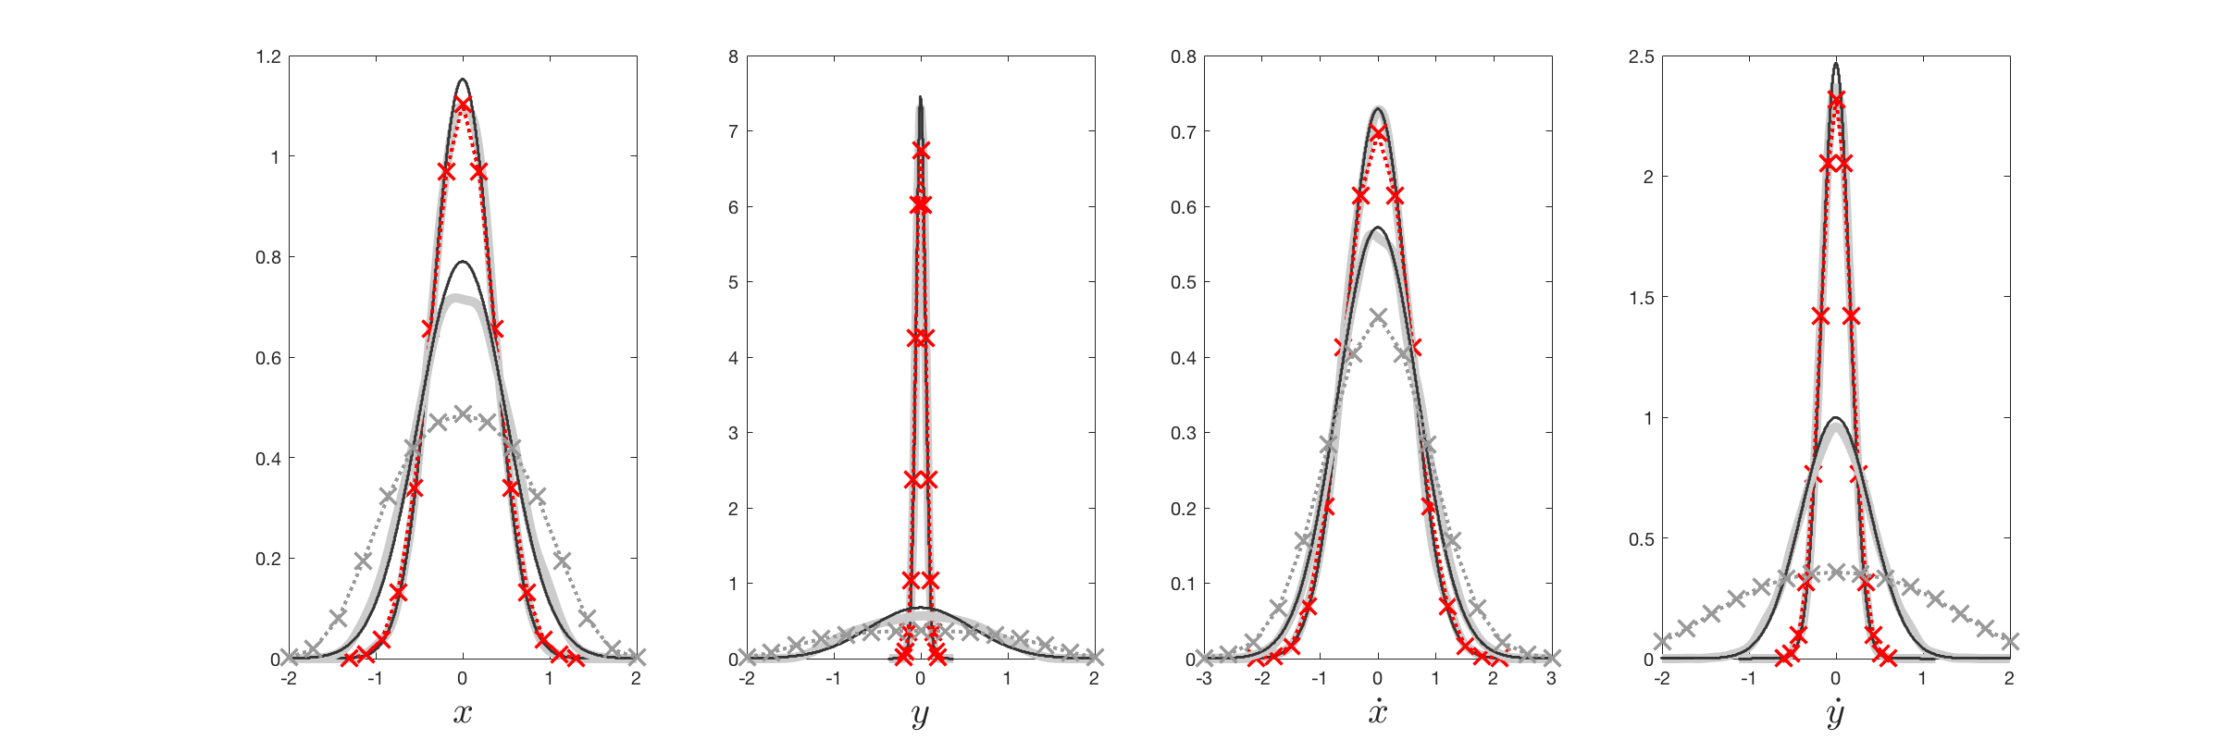
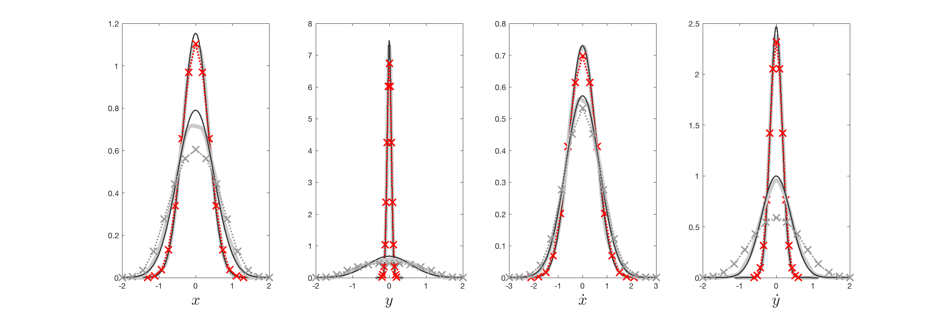
2nd Example: Partially forced 2 DOF oscillator
MCS
Statistical Linearization
nonlinear eq. of motion
nonlinear constraint
x x x
WPI
t=1 sec
t=3 sec

Slide 17
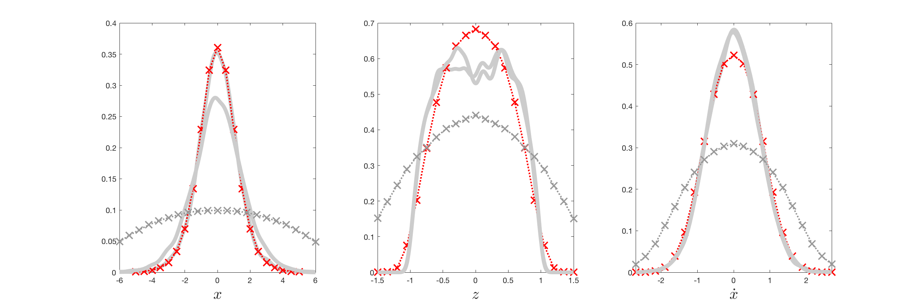
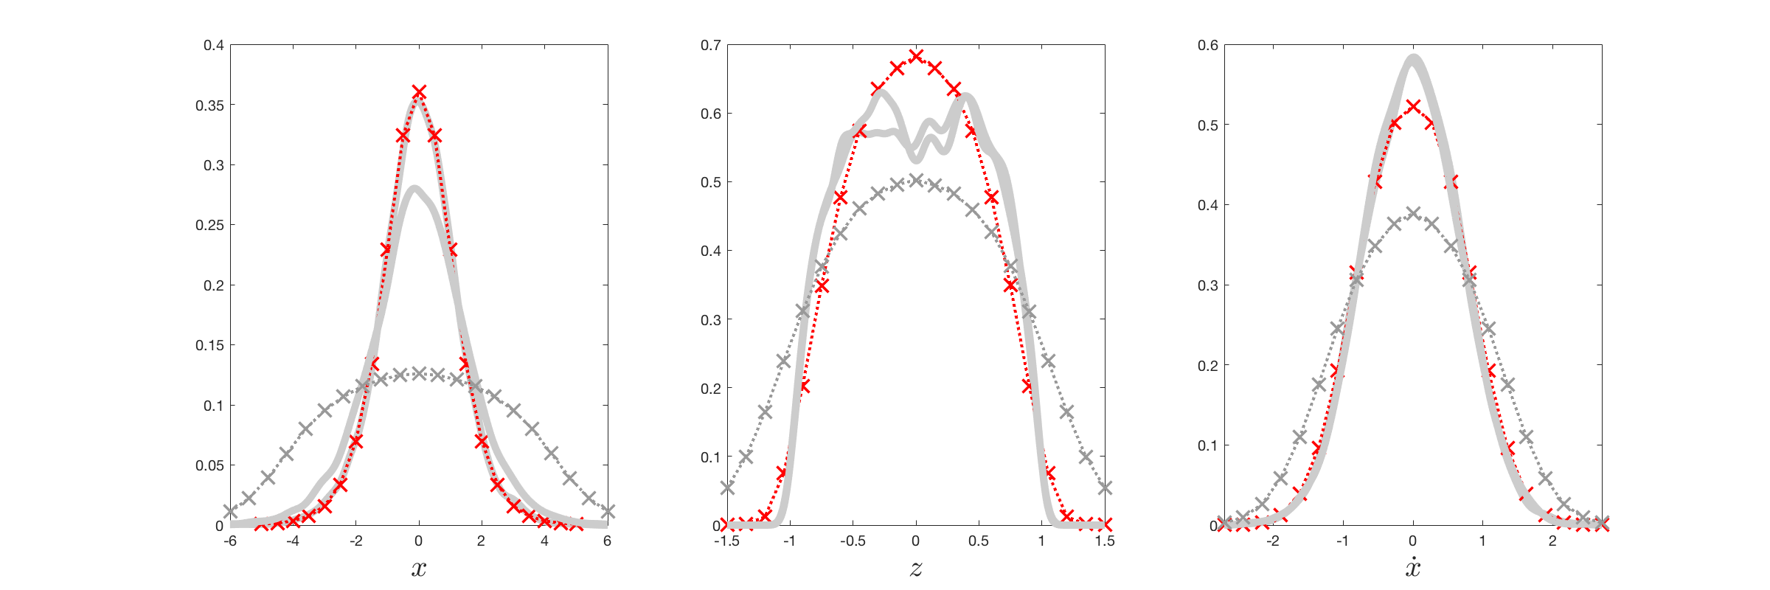
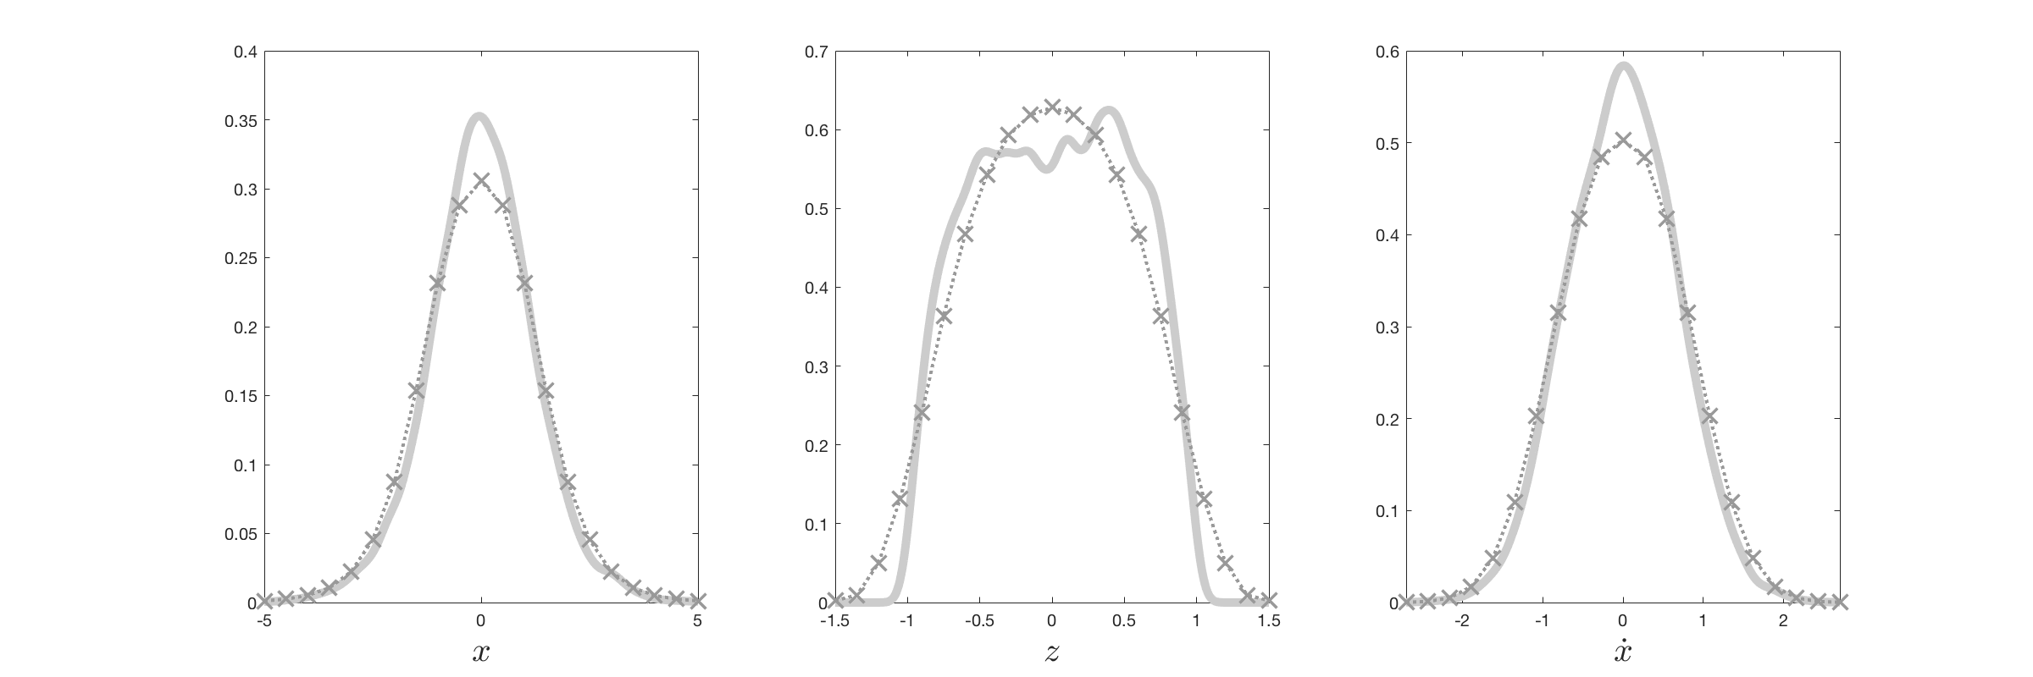
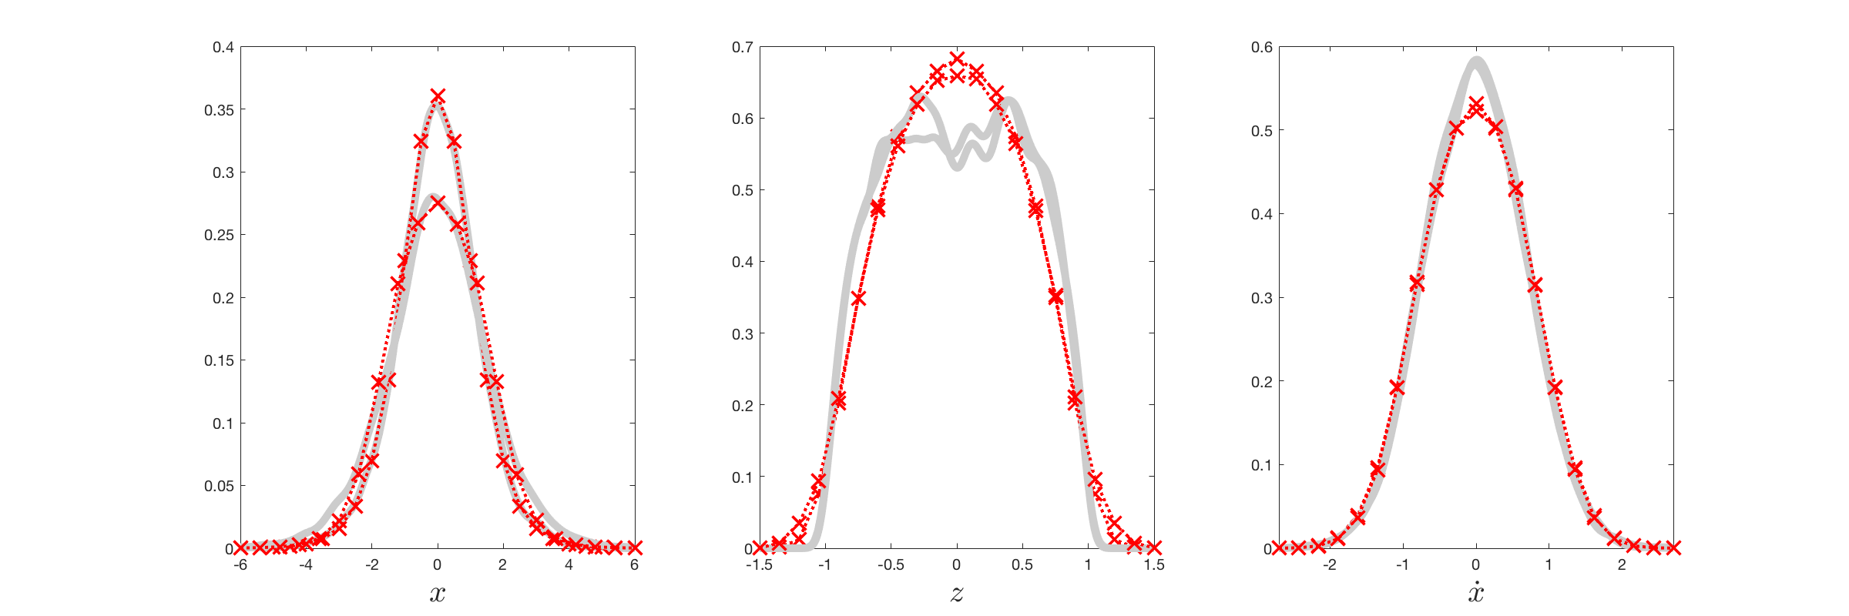
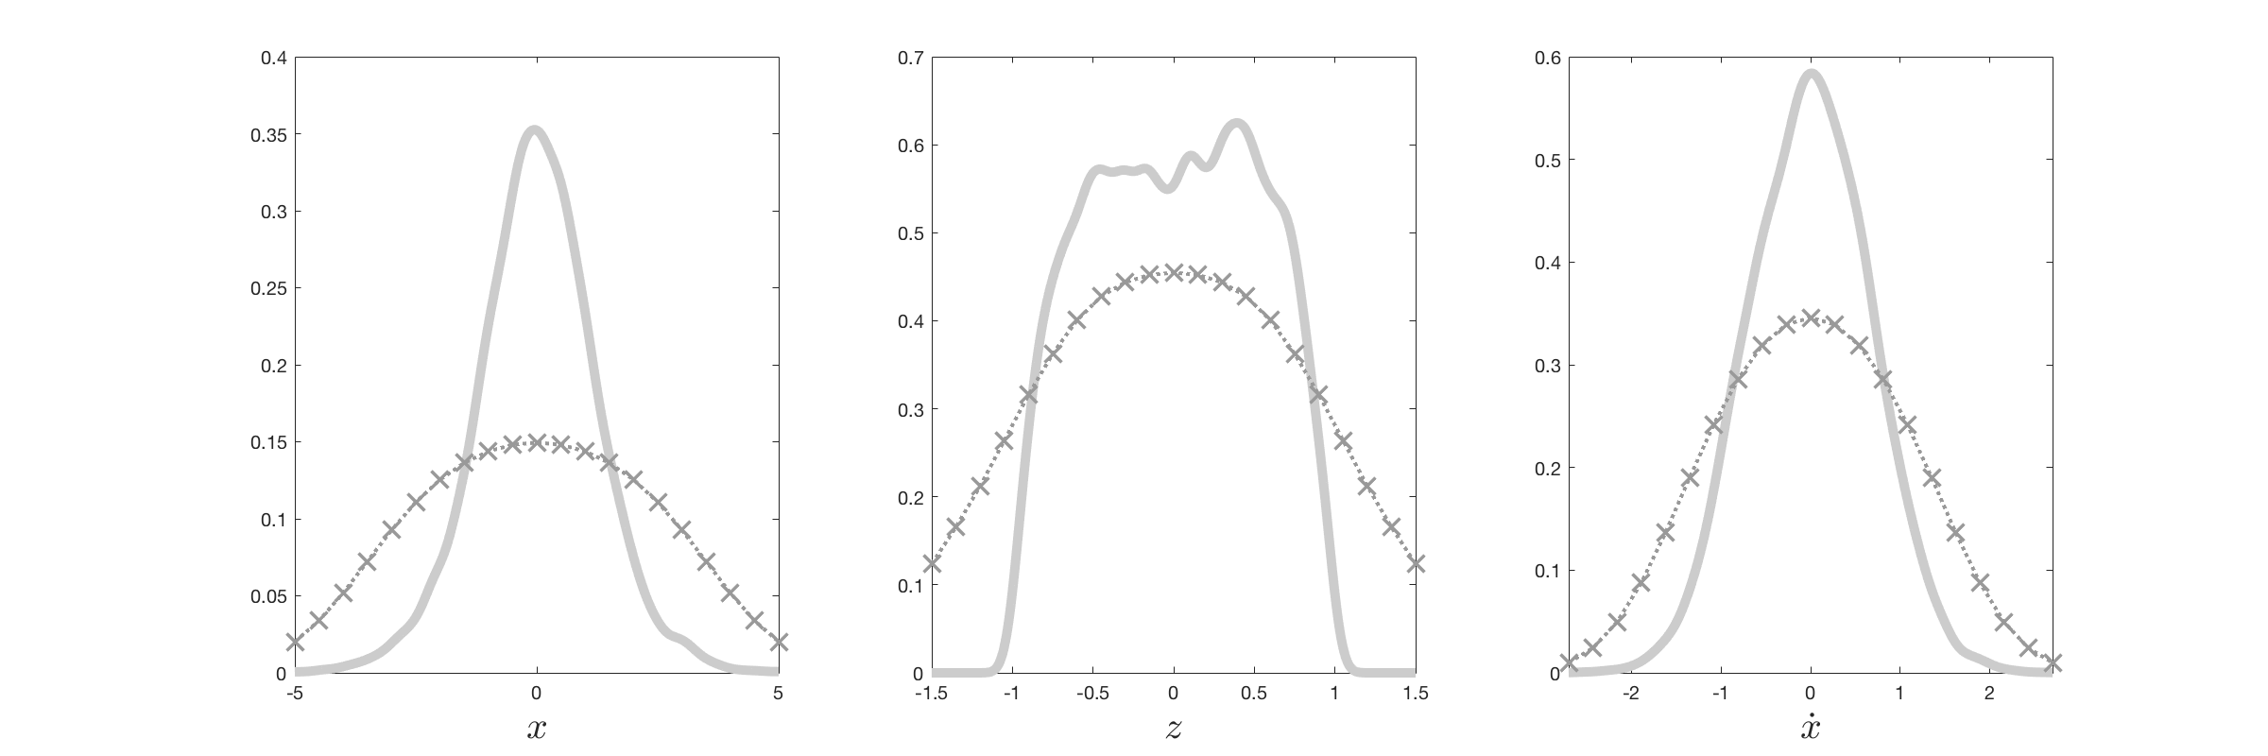
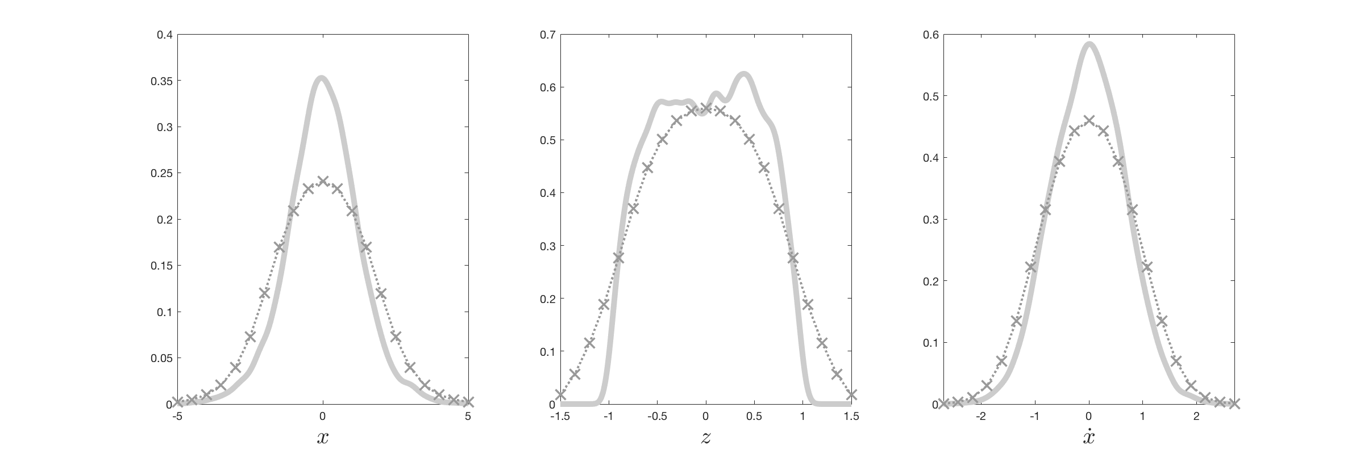
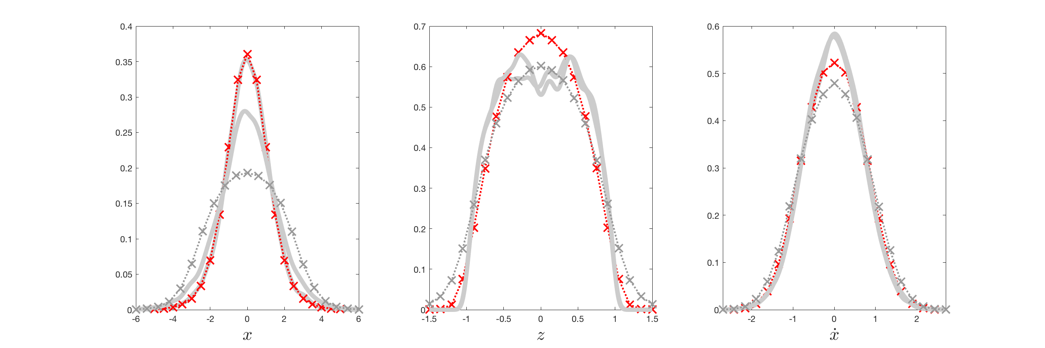
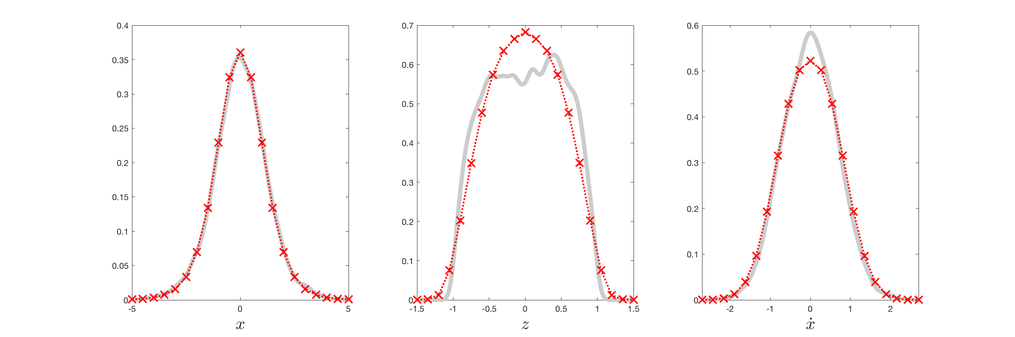
3rd Example: Bouc-Wen hysteretic oscillator
system equation
constraint
Marginal response PDFs for ν = 1 at t = 10 and 20 sec and increasing penalty factor μ

Slide 18
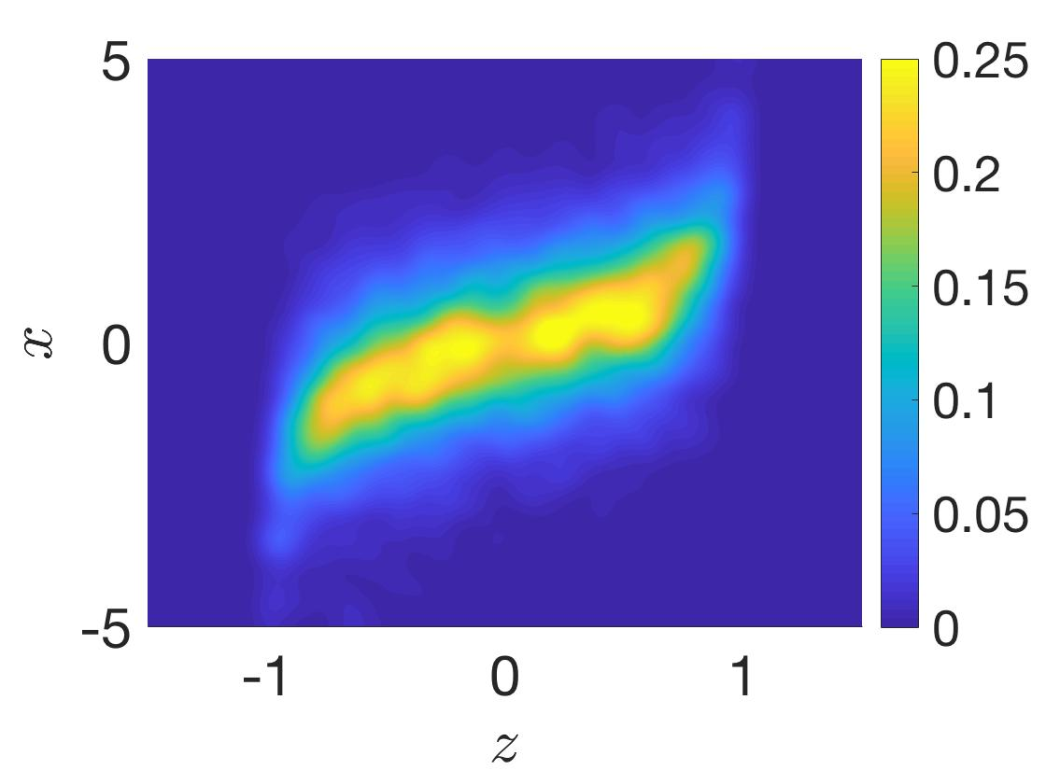
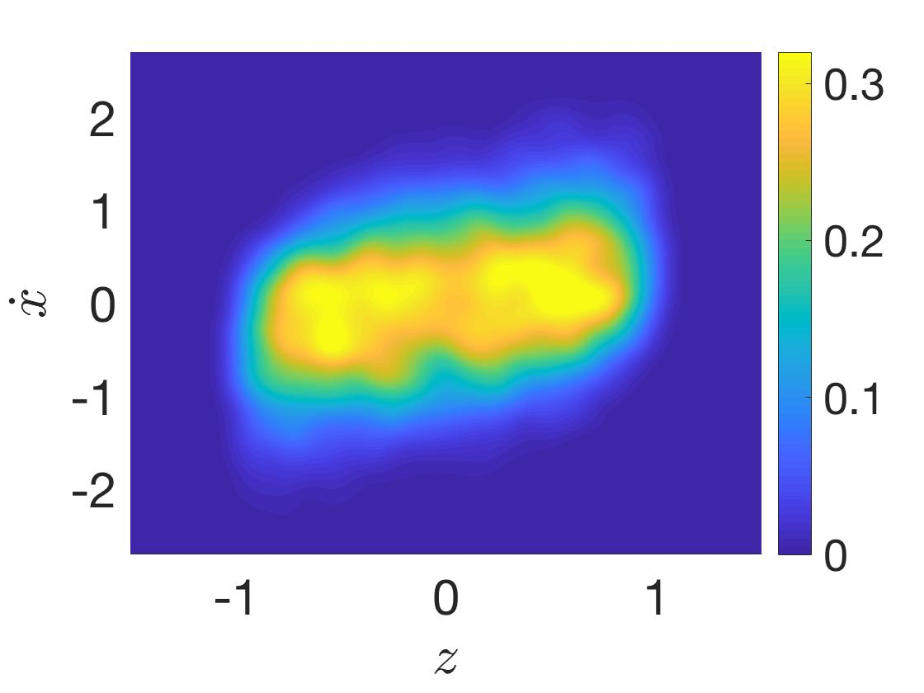
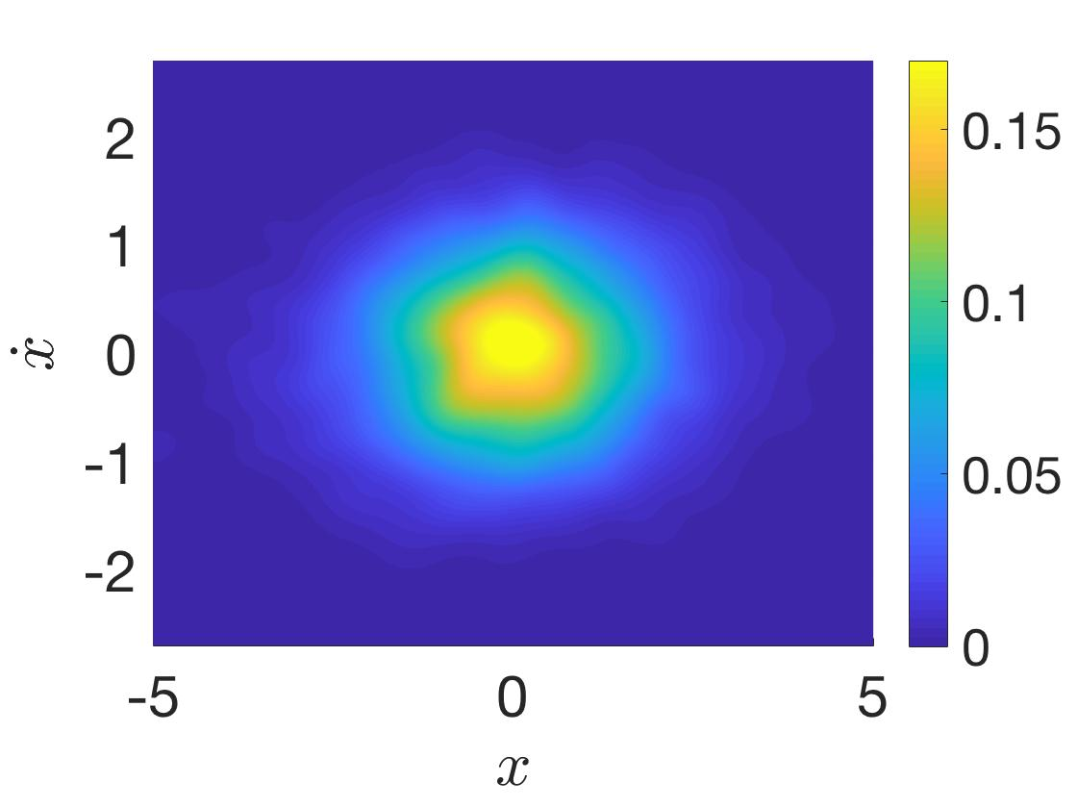
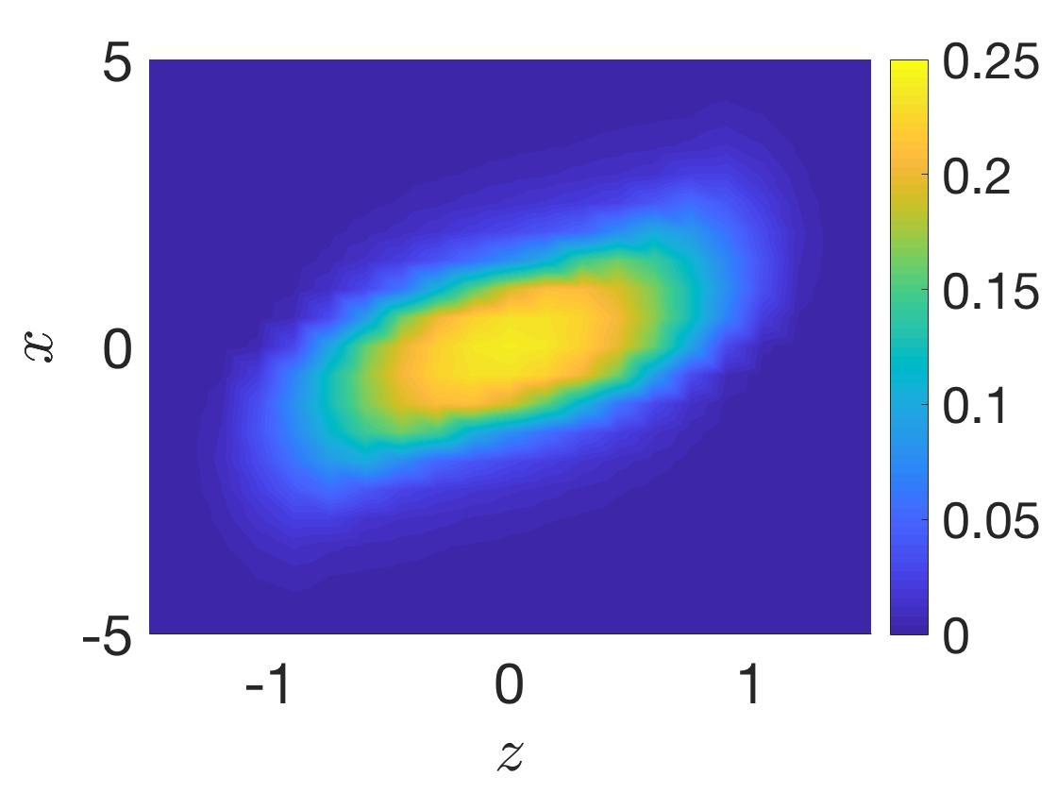
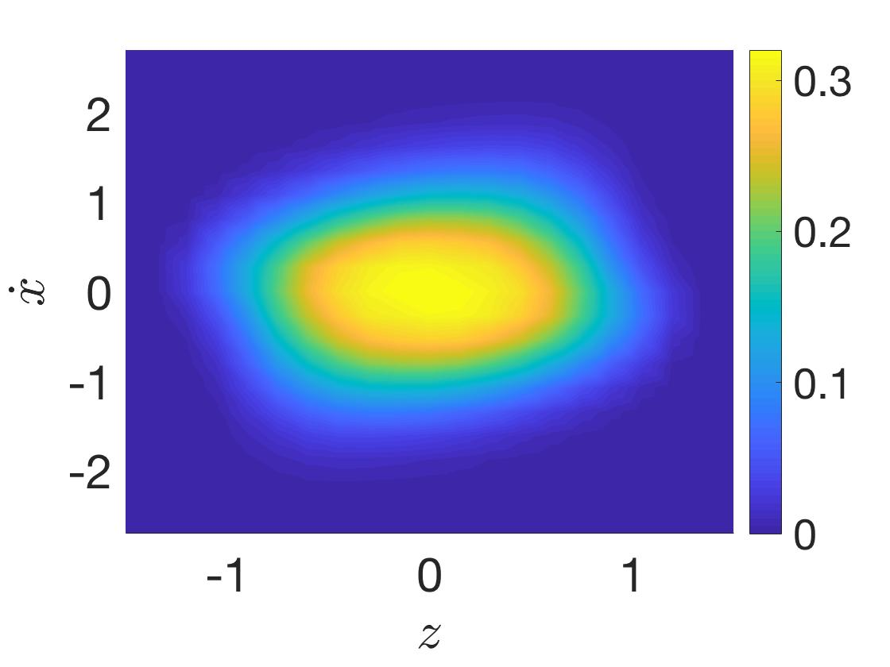
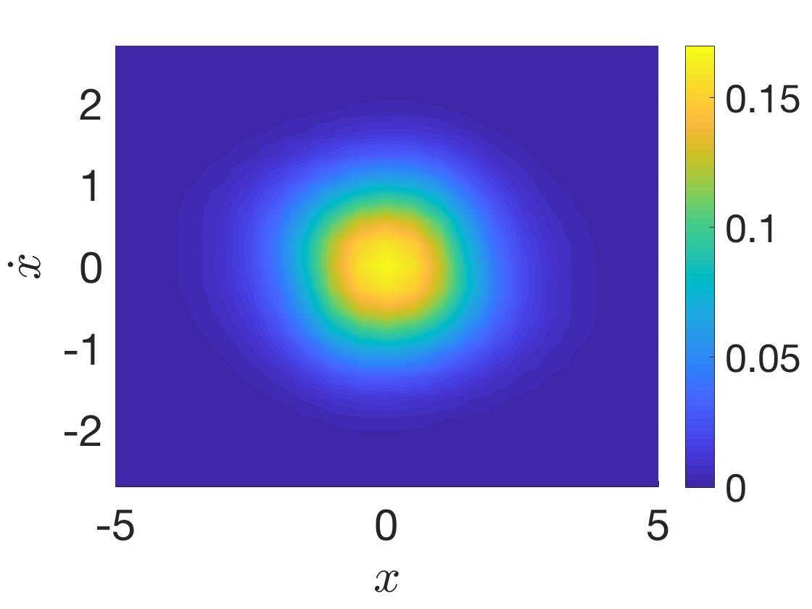
3rd Example: Bouc-Wen hysteretic oscillator
2D joint response PDFs for ν = 1 at t = 15 sec
MC 10000
realizations
WPI – Augmented Lagrangian
method

Slide 19
Outline
Introduction
Wiener path integral (WPI) technique
Standard formulation
Modification
E-L equations and Lagrange Multipliers
Rayleigh-Ritz and Constrained Optimization
Linear constraints
Nonlinear constraints
Conclusions

Slide 20
Conclusions
Modification of the standard WPI technique to account for systems with singular diffusion matrices
Separation of the system equations into two underdetermined sub-systems and formulation of a constrained variational problem
E-L equations and Lagrange multipliers
Theoretically rigorous – Calculus of Variations
Computational limitations
Rayleigh-Ritz and constrained optimization
Approximate but more versatile
Linear constraints: Nullspace approach (very efficient)
Nonlinear constraints: Augmented Lagrangian method
Examples: Partially forced MDOF oscillators with linear and nonlinear constraints, Bouc-Wen hysteretic oscillator

Slide 21
Thank you!

Slide 22
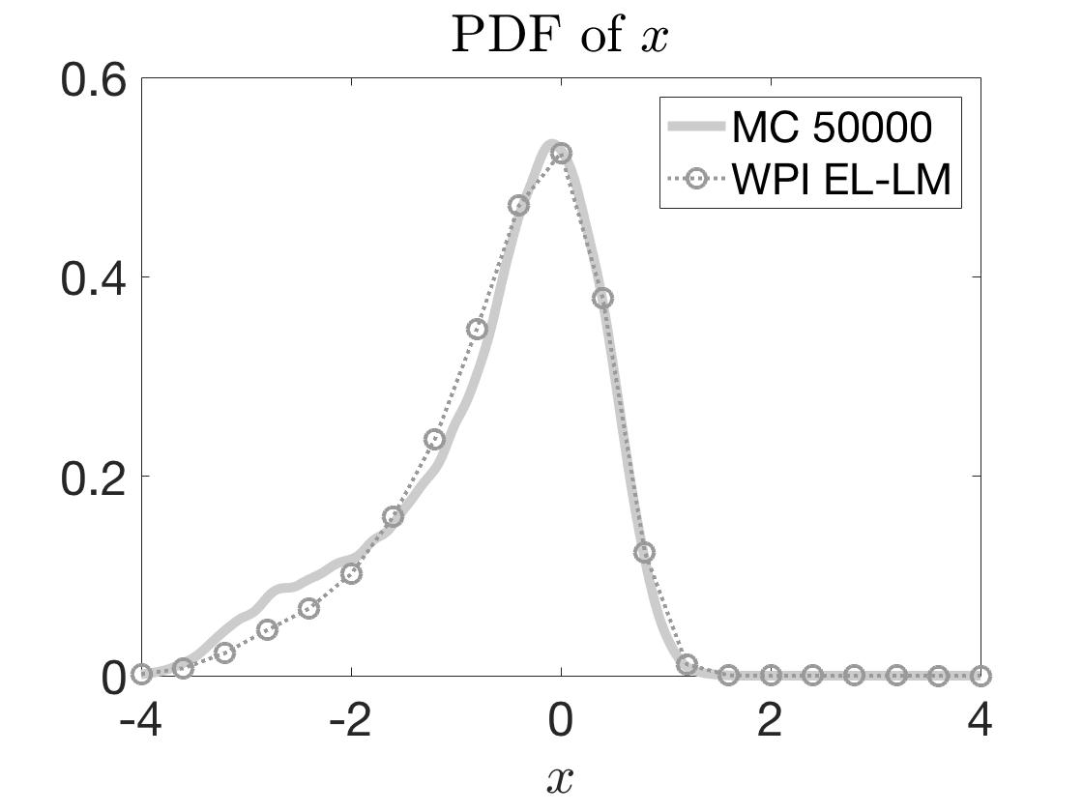
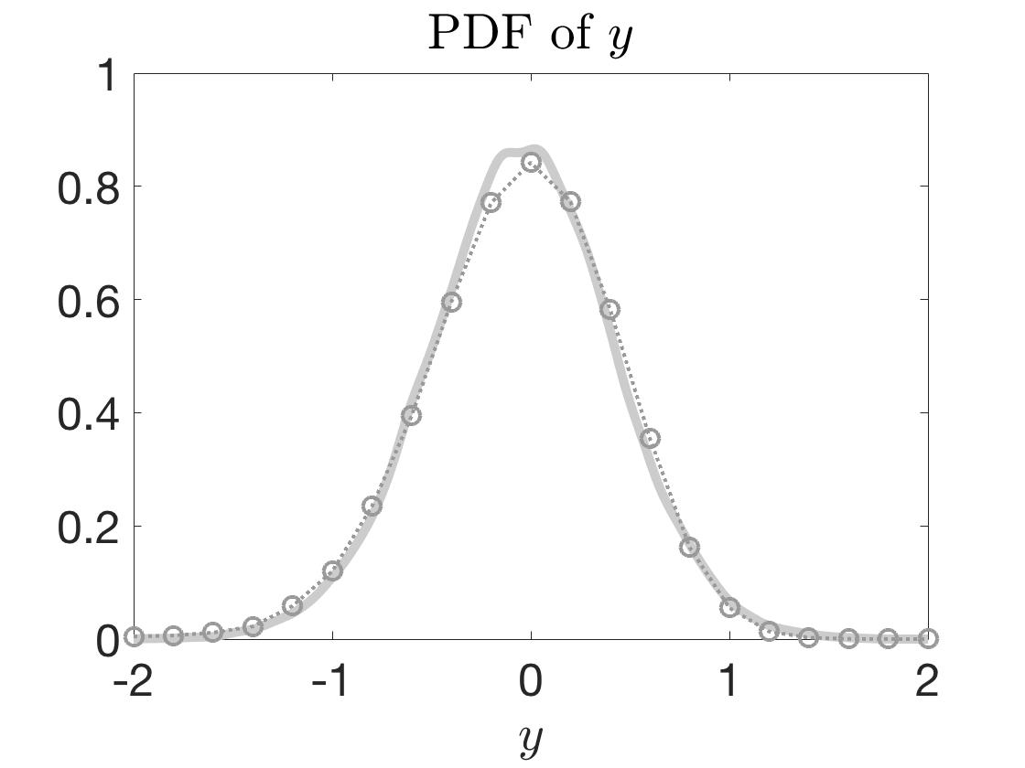
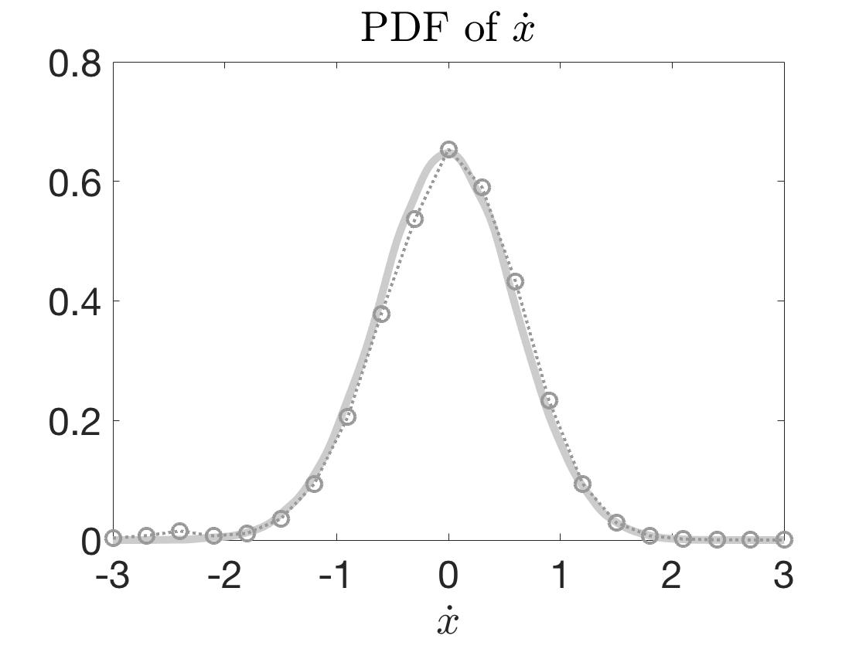
Appendix: Nonlinear energy harvester example
Solution: EL equation and Lagrange multipliers
marginal response PDFs

